Slide 1
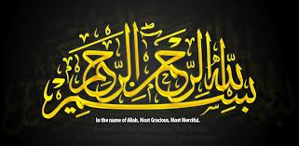
EXEMPLARY Personalities and practices for Muslims Public relations practitioners for all times¹
Firstly, I would like to thank Allah SWT
for making this wonderful event to
happen and allowing me to participate.

Slide 2
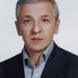
\
Secondly, my gratitude to The International Association
for Muslim Public Relations & Communication
Practitioners (IAMPRC), especially
Brother Mehdi Bagherian,
the organising chairman for inviting
me to speak at the 2nd IAMPRC held in
Tehran, Iran from 8th to 9th December 2012.
I am most grateful for the invitation.
It has enabled me to share my thoughts
& experiences with PR and communication
leaders, managers, scholars and experts
worldwide, Muslims and non-Muslims.

Slide 3
I am positive the outcome of the 2nd IAMPRC Global Congress will be useful to Muslims Public Relations and Communication practitioners and scholars globally as it was for the 1st IAMPRC Congress. Maybe, it will even be useful for non-Muslim Public Relations and Communication practitioners and scholars or organizations who want to know Muslims experts better and work with us to make the world a peaceful and prosperous place.

Slide 4
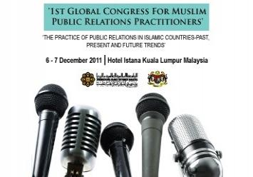
It was noted that the 1st IAMPRC Global Congress in Kuala Lumpur, Malaysia was a success. In fact, a significant number felt that it was great success. This was concluded by both Muslim and non-Muslim participants.
As a participant to it, I fully agree with their observations.
Mind you, this is not because it was held in Malaysia, my home country. I made this conclusion after taking to more than 30 participants local and international, Muslims and non-Muslims, plus 10 paper presenters.

Slide 5
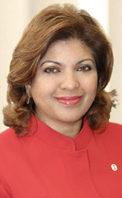
According to Shameen Abdul Jalil,
there were 4 significant outcomes
of 1st IAMPRC Global Congress:
C
Co-chair of 1st IAMPRC Global Congress, Shameen Abdul Jalil
Launching of IAMPRC;
Thank You Letter to World Editors from IAMPRC;
An Exhibition in conjunction with the Congress
A special publication on the proceedings.
The most significant result is
the IAMPRC. Formation.
This 2nd IAMPRC Congress proves that it
can not only be sustainable but also
grow stronger and more influential.
Insya-Allah or God willing it will be realised.

Slide 6
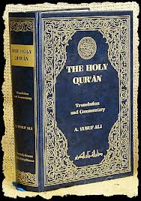
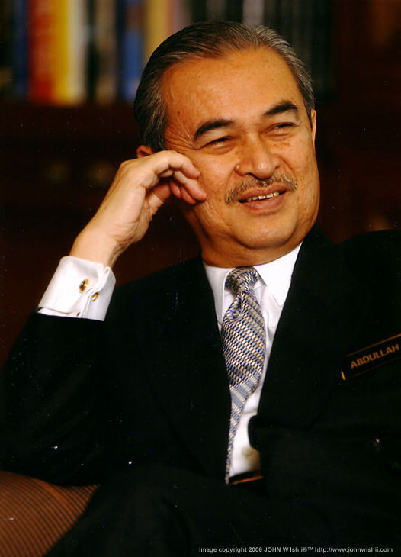
Malaysia’s Former PM Tun Abdullah Badawi
in addressing IAMPRC 1ST Congress referred to 2 prerequisites for Muslim PR Professionals:
Justice & Accountability.
These are essential prerequisites for
all Muslims PR Practitioners if we want the profession to be respected & have the necessary credibility. By upholding the Qur’an & the Sunna we will be effective in practicing our profession.

Slide 7
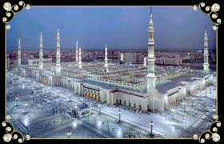
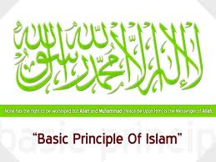
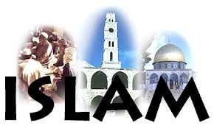
At the
At the1st AMPRC Congress, many significant
Speakers also linked the core Islamic
principles to PR practice.
Of particularly importance to PR
practice to them are justice,
accountability and shura – the seeking of mutual agreement or consensus, without which no authority has legitimacy.
They echoed Abdullah Badawi called.
“Prophet Muhammad’s communicative values of liberty, justice, modesty, and politeness were matched with practical deeds. His skilful use of rhetoric demonstrated his commitment for meaningful competent communication for humankind in general. His speeches demonstrate that he sought to see all humankind from the lens of kindness, modesty, moderation, justice, liberty, gentility, generosity and love.”

Slide 8
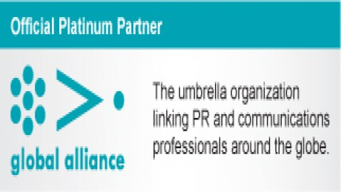
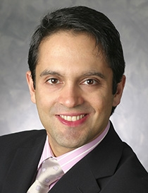
One of the notable non-Muslim speakers, Chair of the Global Alliance for Public Relations and Communication Management, popular known as GA, Daniel Tisch referred to the concepts of justice and accountability -- long-established principles of the Islamic faith -- and their pertinence for the field of public relations in the modern world.
According to Tisch, while different
terms were employed in PR theory,
these principles were reminiscent
of some of the most important trends relevant in PR today.

Slide 9
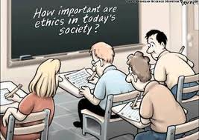
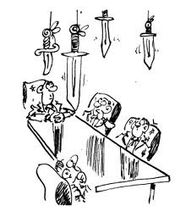
Tisch commented that while these are ancient ideas in Islamic thought (teaching), they could not be more relevant to modern PR. For example, Tisch consider the importance of ethics, transparency, authenticity, accountability & mutual understanding to successful corporate communication & stakeholder governance.
Daniel Tisch statement reflected increasing similarities in the PR practice prerequisites to make the profession a very credible one and to ensure its standing can be quickly ascertained as a true vocation for all times.

Slide 10
Shura, was the recurrent theme for the 3- day inaugural IAMPRC Global Congress.
Islam encourages Muslims to decide their affairs in consultation with those who are affected by the decisions.
Thus, shura should be the core element of Muslim PR & communication practice & education.

Slide 11
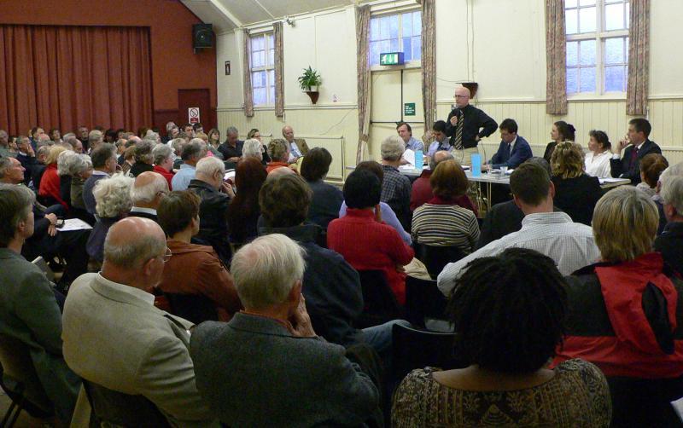
The principle of shura in Islam is predicated on three basic precepts. There are: (1) All persons in any society are equal in human and civil rights; (2) Public issues are best decided by majority view; and (3) The principles of justice, equality and human dignity, which constitute Islam’s moral core, ... are best realised, in personal as well as public life, under shura governance.
Thus, shura must be the core of Muslim PR practice & education.

Slide 12
Today, sadly, there is the tendency to believe that
good governance including public consultation or
shura & PR have originated from the West.
Lecturers who have studied in the West, especially in USA, further convey this fallacy to students in non-western nations, including Islamic countries.
The reality is every civilization and each government
will have to practice public consultation or shura & effective PR within its own context & environment in order to be sustainable & effective.
In Islam, shura or public consultation
is encouraged, if not mandatory.

Slide 13
Done well, shura generates mutual benefit,
with all parties learning from each other
through sharing knowledge, expertise & skills.
This process or action can build trust,
understanding & collaboration.
Thus, it will increase PR relevance & its impact .
As PRO are bridges or moderators between organisations & target publics, we need to further enhance our public consultation or engagement skills, that is if I may say so our shura & good governance expertise.
I believe IAMPRC can play this essential role.

Slide 14
Today, shura practice share most in common with
participatory democracy & seen by many as
complementing representative democratic systems.
Shura engagement puts decision-making
powers more directly with the people or in the case
of organizations in its ordinary member’s hand.
Thus shura approach demonstrates that “no one
is a master of another” & that all of us are equally dependent on each other, while being Muslims we are all equal in the eyes of Allah SWT.

Slide 15
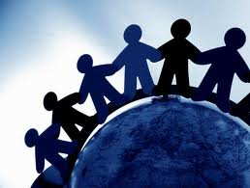
Thus, practicing shura I believe will enhance democratic practices & decision-making processes & sense of belonging motivating citizens or members to participate actively for everybody betterment & protecting public interest.
Today many Muslim nations or the so-called ones are perceived as non-democratic. Surely, they are not practicing shura as Islam prescribe.
IAMPRC as a body for Muslim PR &
communication experts can play an
essential role promoting shura.

Slide 16
I strongly feel that shura which is essential to the practice of democracy and a prerequisite for good governance should be very agreeable to the current universal practice.
Therefore, I fully believe it will have an excellent acceptance level not only to the West but also to all religious faiths who give priority to open communication and the voice of the people.

Slide 17
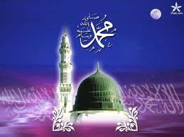
Very rightly, the 1st IAMPRC Global Congress in KL recognized the Prophet Muhammad SAW as
the founder of Muslim PR.
As a Muslim, I should say with full believe , not only our
greatest and last Prophet be recognized as the founder of
Muslim PR but also the greatest for all time.
His teaching should be the
foundation of our practice.
The IAMPRC should be looking for ways to educate
& train Muslim PR and communication experts to
emulate our Rasulullah and his four closest companions.

Slide 18
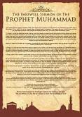
“Prophet Muhammad’s communicative values
of liberty, justice, modesty, and politeness
were matched with practical deeds.
His skilful use of rhetoric demonstrated his
commitment for meaningful competent
communication for humankind in general.
His speeches demonstrate that he sought
to see all humankind from the lens of kindness,
modesty, moderation, justice, liberty, gentility,
generosity and love.”
The IAMPRC statement issued at its inaugural Global Congress declared:
“Prophet Muhammad’s communicative values of liberty, justice, modesty, and politeness were matched with practical deeds. His skilful use of rhetoric demonstrated his commitment for meaningful competent communication for humankind in general. His speeches demonstrate that he sought to see all humankind from the lens of kindness, modesty, moderation, justice, liberty, gentility, generosity and love.”
“Prophet Muhammad’s communicative values of liberty, justice, modesty, and politeness were matched with practical deeds. His skilful use of rhetoric demonstrated his commitment for meaningful competent communication for humankind in general. His speeches demonstrate that he sought to see all humankind from the lens of kindness, modesty, moderation, justice, liberty, gentility, generosity and love.”

Slide 19
I feel it is essential to offer the supreme role
models in Islam who would maintain the
competency and integrity of Muslim PR &
communication experts.
In today’s world it has become
extremely difficult to find role
models that can guide us to
reach the peak of our profession.
It is said that the chief characteristics great
people share across time is that they are
credible & very effective communicators
& skillful public relations practitioners.

Slide 20
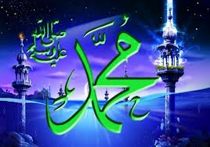
There is no person in history so much maligned and yet always redeemed than the
Prophet Muhammad SAW.
Recently, those who cast aspersions on the Prophet Muhammad SAW are not scholars but rather people who never take the time to study him in details. Surely, it will make Muslims worldwide react to such blasphemy. Some can include violence and death.
Whom should we blame for such incidents? Is it the perpetrators or those who feel that they have been maligned? The western ideology tends to uphold their principle of freedom of speech even though they know it can lead to dire consequences and often impose their will upon others.

Slide 21
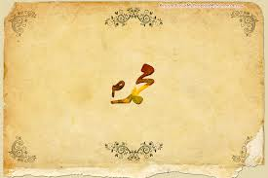
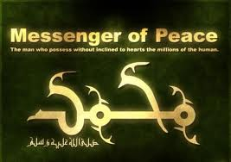
It must be reminded that some very prominent
non-Muslims have only the highest respect
for Prophet Muhammad SAW.
They included academics, writers,
philosophers, poets, politicians & activists
belonging to the East and the West.
None of them were reported to become Muslims.
Therefore, their writings reflect their personal
Views on various aspects of the life of the Prophet.

Slide 22
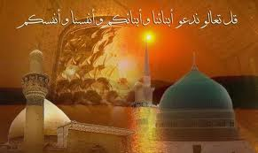
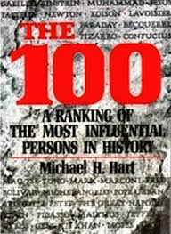
Michael H. Hart (1932- ) Professor of
astronomy, physics & the history of science said that his choice of Muhammad to lead the list of the world's most influential persons may surprise some readers & may be questioned by others,
but he was the only man in
history who was supremely
successful on both the religious
& secular level."
[The 100: A Ranking of the Most Influential Persons in History, New York, 1978, p. 33]

Slide 23
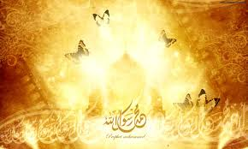
Hart asserted that Muhammad
SAW was "supremely successful"
in both religious & secular realms.
He also believed that Muhammad's
role in the development of Islam was far more influential than Jesus'
collaboration in the
development of Christianity.

Slide 24
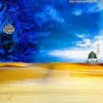
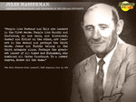
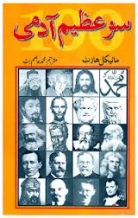
According to Hart, the Prophet Muhammad SAW
was the only person in history who was supremely
successful on the religion and secular levels as well
as a military leader. In fact, as the driving force
behind the Arab conquest, Muhammad SAW may
well rank as the most influential leader of all time.
The Arab conquests of the seventh century have
continued to play a crucial role in human history,
down to the present times.
Thus according to Hart (1978) it is this unparalleled
combinations of secular and religious influence that
entitles Prophet Muhammad SAW to be considered
the most influential single figure in human history.

Slide 25
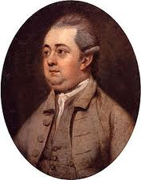
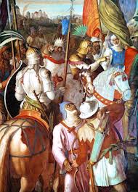
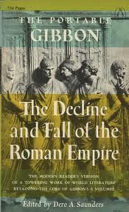
Edward Gibbon (1737-1794) considered
the greatest British historian of his time
said of Prophet Muhammad SAW:
"The greatest success of Mohammad's
life was affected by sheer moral force
without the stroke of a sword"
[History of the Saracen Empire, London, 1870].
He added; "His (i.e., Muhammad's) memory
was capacious & retentive, his wit easy &
social, his imagination sublime, his judgment
clear, rapid and decisive. He possessed the
courage of both thought and action.“
[History of the Decline and Fall of the Roman Empire, London, 1838, vol.5, p.335]

Slide 26
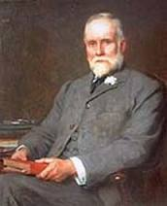
Reverend Bosworth Smith (1794-1884)
Late Fellow of Trinity College, Oxford,
Praised Prophet Muhammad SAW:
"… he was Caesar and Pope in one;
but he was Pope without the Pope's
pretensions and Caesar without the legions of
Caesar. Without a standing army, without a
bodyguard, without a palace, without fixed
revenue, if ever any man had the right to say
that he ruled by a right Divine, it was Mohammed;
for he had all the power without its instruments
& without its supports.“
Mohammed and Mohammedanism, London, 1874, p. 235]

Slide 27
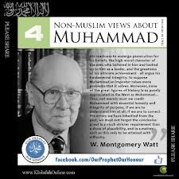
William Montgomery Watt (1909- )
Professor (Emeritus) of Arabic &
Islamic Studies at the University of
Edinburgh said of the Prophet:
"His readiness to undergo persecutions for his beliefs,
the high moral character of the men who believed in
Him & looked up to him as leader, & the greatness
of his ultimate achievement - all argue his fundamental integrity.
To suppose Muhammad an impostor raises
more problems than it solves. Moreover, none of
the great figures of history is so poorly appreciated
In the West as Muhammad.“
[Mohammad At Mecca, Oxford, 1953, p. 52]

Slide 28
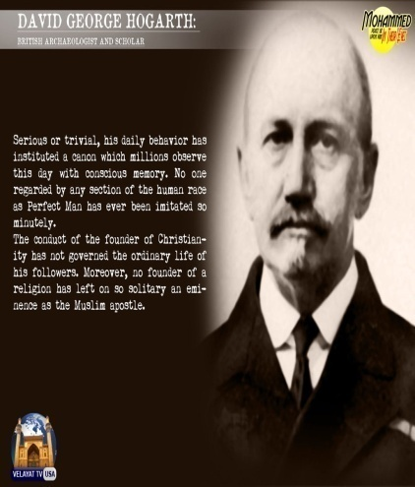
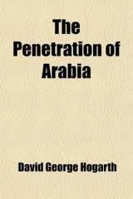
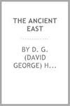
Another English, man David George Hogarth
(1862-1927) archaeologist, author, & keeper
of the Ashmolean Museum, Oxford, said of the
Prophet Muhammad:
“Serious or trivial, his daily behaviour has instituted a canon which millions observe this day (billions) with conscious mimicry. No one regarded by any section of the human race as Perfect Man has been imitated so minutely. The conduct of the Founder of Christianity has not so governed the ordinary life of His followers.
Moreover, no Founder of a religion has been left on so solitary an eminence as the Muslim Apostle.
”[Arabia, Oxford, 1922, p. 52]

Slide 29
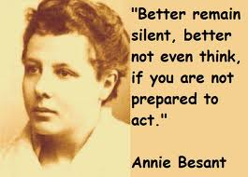
Similarly, Annie Besant (1847-1933) British
Theosophist & nationalist leader in India,
President of the Indian National Congress
in 1917 admitted:
"It is impossible for anyone who studies the life
& character of the great Prophet of Arabia,
who knows how he taught and how he lived,
to feel anything but reverence for that mighty
Prophet, one of the great messengers of the
Supreme. And although in what I put to you I
shall say many things which may be familiar to
many, yet I myself feel whenever I re-read them,
a new way of admiration, a new sense of reverence
for that mighty Arabian teacher."
[The Life and Teachings of Muhammad, Madras, 1932, p. 4] MHA

Slide 30
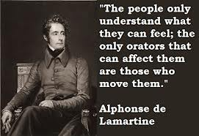
Alphonse de Lamartine (1790-1869)
French poet & statesman said this of
Prophet Muhammad SAW:
"If greatness of purpose, smallness of
means & astounding results are the
three criteria of human genius, which
could dare to compare a great man
in modern history with Muhammad?
Philosopher, orator, apostle, legislator, warrior,
conqueror of ideas, restorer of spiritual empire
that is Muhammad. As regards all standards by
which human greatness may be measured, we
may well ask, is there any man greater than he?
"[Translated from Histoire De La Turquie, Paris, 1854, vol. II, pp. 276-277] MHA

Slide 31
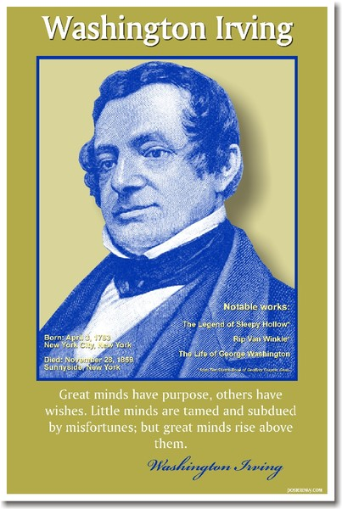
Washington Irving (1783-1859) Well-known as the “first
American man of letters“ praised Prophet Muhammad:
“He was sober and abstemious in his diet, & a
rigorous observer of fasts. He indulged in no
magnificence of apparel, the ostentation of
a petty mind; neither was his simplicity in
dress affected, but the result of a real disregard
to distinction from so trivial a source ... In his private dealings he was just. He treated friends and strangers, the rich and poor, the powerful and the weak, with equity, & was beloved by the common people for the affability with which he received them, & listened to their complaints ... His military triumphs awakened no pride nor vain glory, as they would have done had they been effected for selfish purposes. In the time of his greatest power he maintained the same simplicity of manners and appearance as in the days of his adversity. So far from affecting regal state, he was displeased if, on entering a room, any unusual testimonial of respect were shown to him.“[Life of Mahomet, London, 1889, pp. 192-3, 199]MHA

Slide 32
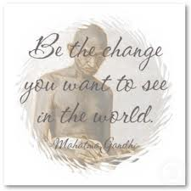
Mohandas KaramchandGandhi (1869-1948)
Indian thinker, statesman, and nationalist
Leader also had the highest regard for
Prophet Muhammad SAW. He said:
“....I became in the scheme of life. It was the
rigid simplicity, the utter self-effacement of
the prophet, the scrupulous regard for his
pledges, his intense devotion to his friends
& followers, his intrepidity, his fearlessness,
his absolute trust in God and in his own mission.
These and not the sword carried everything before
them and surmounted every trouble."
[Young India (periodical), 1928, Volume X] MHA

Slide 33
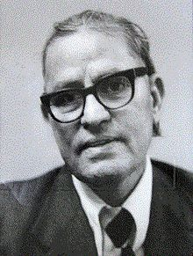
Afzalur Rahman, a renowned Islamic declared that
Prophet Muhammad SAW is the greatest educator
of humankind. Rahman (1980) wrote:
“Muhammad was not educated in any school
or university nor did he learn reading or
writing in his boyhood. He was totally
illiterate. But he was able to teach psychology, philosophy & the principles of education to his companions. He taught them the fund fundamental
principles of morality, ethics & religion & the wealth of eternal values and standards which formed the basis of their culture in all its many dimensions, including education, literature, philosophy, economics, architecture, physics, medicine, astronomy, politics,
business science, psychology, physiology,
biology, and scores of other fields of knowledge.” MHA

Slide 34
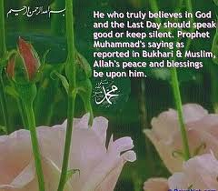
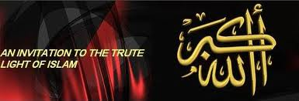
In addition, it must be said Prophet Muhammad SAW is the most quoted person in history. His words & actions have become the guiding lights of Muslims and Islamic nation across the ages. Almost all of his actions & the words he uttered was recorded and being used as a model to every Muslims.
Thus, very rightly so he should be guiding
light of every Muslim Public Relations
professionals & to IAMPRC.
Mohd Hamdan Adnan

Slide 35
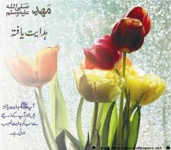
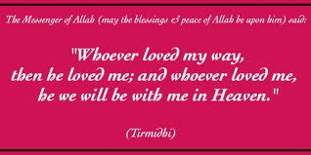
Six of the Prophet Muhammad SAW sayings that
I feel useful for PR and communications experts are:
1. Believers are accessible and mild (easy to reach,
to talk to and ever willing to help (Tirmizi).
2.Believers are not one who taunts or curses or acts
indecently or speaks vulgar languages (Tirmizi).
3.Indeed, modesty and faith are companions. Thus,
if one of the two is removed then the other
is also removed (Tirmizi). MHA

Slide 36
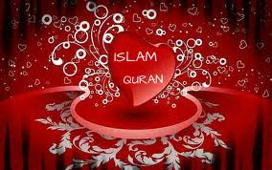
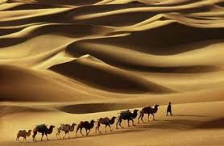
4. The best among you is he from who good is expected
& there is confidence (among people) that no harm (evil)
will come from him. And the worst of you is he from whom
good is not expected and from whose mischief there is no
security for the people (Tirmizi: Narrated by Abu Hurayah).
55. Believers who have the most perfect faith are
those whose manners are the best (Abu Dawood:
Narrated by Abu Hurayah).
6.A Believer is one who loves. And, he has no good
in him who does not love and whom people do
not love (Ahmad: Narrated by Abu Hurayah). MHA

Slide 37
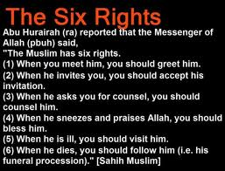
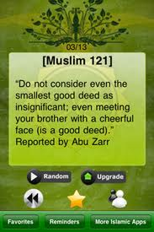
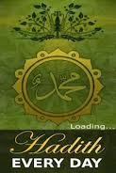

Slide 38
He was called Al-Siddiq (The Truthful) and was known by that title among later generations of Muslims. Abu Bakr (Abdullah ibn Abi Quhafa) (Arabic: عبد الله بن أبي قحافة, Transliteration: Abū Bakr as-Șiddīq (Arabic: أبو بكر الصديق) was a senior companion (Sahabi) and the father-in-law Prophet Muhammad SAW. He served as a trusted advisor to Prophet Muhammad SAW.
Abu Bakr ruled over the Rashidun Caliphate from 632–634 CE when he became the first uslim Caliph following Prophet Muhammad's death.
MHA

Slide 39
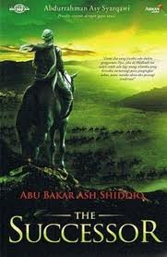
Abu Bakr was a very gentle, soft-spoken and kind-hearted man.
He was instrumental in bringing to Islam influential personalities of the Mecca’s community.
Also, he was the saviour of
many of the most unfortunate
early Muslims, especially the
Slaves among them. When
demanded, Abu Bakr was never hesitant in his words and actions. MHA

Slide 40
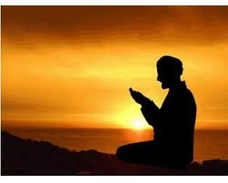
Below are a few significant sayings of Abu Bakr that I feel
will be useful to PR practitioners and communicators:
No speech is good if it is not directed
toward the pleasure of Allah.
2. There is no benefit from money if it
isn't spent in the cause of Allah.
3 There is no good in a person if his
ignorance overcomes his patience.
And if a person becomes attracted by
the charms of this lower world,
Allah will dislike him as long
as he keeps this in his heart.“ MHA

Slide 41
4. Be kind to the men under
you & treat them well.
5. Directions given should be
brief. If too long, they are
likely to be forgotten.
6. Improve your conduct first;
others will improve when
they see your example.

Slide 42
7. Be always truthful so you
can get good advice.
8. Be sincere to all whom
you have dealings.
9. Beware of cowardice
& dishonesty. MHA

Slide 43
Umar (Arabic: عمر ابن الخطاب, Transliteration: `Umar ibn Al-Khattāb, Umar Son of Al-Khittab, c. 586–590 CE – 7 November 644), was one of the most powerful and influential Muslim rulers.
He was a companion of Prophet Muhammad SAW. Umar was born in Mecca around 581 to the Adi clan of the Quraish tribe. He belonged to a family of average class, but he was able to become literate.

Slide 44
Umar (RA) succeeded Abu Bakr
(632–634) as the second Rashidun Caliphate on 23 August 634.
He was an expert jurist & is best known for his justice, which earned him the title Al-Farooq
(The one who distinguishes between right and wrong).

Slide 45
Umar, was more feared than loved. The first challenge for Umar was to win over his subjects and members of Majlis al Shura. He was a gifted orator, & would use his ability to get a soft corner in the hearts of people.
On Friday prayers Umar
Addressed the people as follow:
“Brethren, it has come to my notice that the people are afraid of me..... They say that he (Umar) has become the Caliph now, God knows how hard he will be. Whoever has said this is not wrong in his assessment...... know ye brethren that you
will feel a change in me. For those who practise tyranny and deprive others of their rights, I will be harsh and stern, but for those who follow the law, I will be most soft and tender.”

Slide 46
Umar's emphasize on the well being of the poor &
underprivileged enhanced his popularity among the
people. His general instructions to his officers were:
"Remember, I have not appointed you as commanders & tyrants over the people. I have sent you as leaders instead, so that the people may follow your example. Give the Muslims their rights and do not beat them lest they become abused. Do not praise them unduly, lest they fall into the error of conceit. Do not keep your doors shut in their faces, lest the more powerful of them eat up the weaker ones. And do not behave as if you were superior to them, for that is tyranny over them."

Slide 47
In his book Mahomet and His Successors,
Washington Irving estimates the achievements
of Umar in the following terms:
“The whole history of Umar shows him to have been a man of great powers of mind, inflexible integrity, and rigid justice. He was, more than anyone else, the founder of the Islam Empire; confirming and carrying out the inspirations of the prophet; aiding Abu Bakr with his counsels during his brief caliphate; and establishing wise regulations for the strict administration of the law throughout the rapidly-extending bounds of the Moslem conquests. The rigid hand which he kept upon his most popular generals in the midst of their armies, and in the most distant scenes of their triumphs, gave signal evidence of his extraordinary capacity to rule.
In the simplicity of his habits, and his contempt for all
pomp and luxury, he emulated the example of the prophet
& Abu Bakr. He endeavored incessantly to impress the
merit &policy of the same in his letters to his generals.”

Slide 48
Umar’s conduct of the state affairs is exemplary.
He combined innovation with the strict observance
of Islamic teaching, firmness with kind-heartedness,
and toughness with a keen sense of justice and
responsibility for the welfare of his subjects.
During his rule, many vital administrative institutions
were established.
Most essential was that his people had easy access to
him and he personally did his rounds in his beloved
state in an effort to gain feedback and make adequate
situation appraisals and the ability to take appropriate
and speedy actions based on insights gained.

Slide 49
Uthman ibn Affan was Prophet Muhammad SAW companion and the fifth person to embrace Islam.
He became the third Caliph of the Muslim Empire at the age of 65 following Umar ibn al-Khattab. Under his leadership, the empire expanded into Fars in 650 (present-day Iran), some areas of Khorasan (present-day Afghanistan) in 651 and the conquest of Armenia was begun in the 640s.
Some of Uthman's notable achievements were the economic reforms he introduced, and the compilation of the Qur'an into the unified, authoritative text that is known today.

Slide 50
Uthman was famed for his good looks and immense generosity, and also for his spiritual closeness to the Holy Prophet of Islam, who included him among the ten who were assured of Paradise.
He commanded the armies of Islam during an age of miraculous conquest and victory in East and West. But he remained famously humble. His sermons brought people to tears. He said:
‘I am astounded at four people: he who knows the world to be temporary, and still chases after it; he who is certain of death &yet makes no plans for it; he who believes in hell, & yet commits sins; & he who believes in Allah, & yet seeks the help of others.’

Slide 51
Uthman was well known for his generosity. It was his trademark until his death.
During Muhammad's time, he financed the project for the construction of the Al-Masjid al-Nabawi & purchased the well Beer Rauma, dedicating it to the free use of all Muslims.
Uthman perhaps could be a most worthy model of today’s corporate captains with regard to social responsibility.

Slide 52
Alī ibn Abī Ṭālib KW was the cousin and son-in-law of Prophet Muhammad SAW & its fourth Caliph ruling from 656 to 661. Ali KW was the first male convert to Islam.
Among the Prophet companions , Ali KW was the most knowledgeable. He had thorough knowledge of the Qur’an, & its interpretation. Ali KW was the best of all judges, & he was the most eloquent orator of the Arabs.

Slide 53
Among Muslims, Sunni & Shia alike, Ali
KW is respected for his courage, knowledge,
belief, honesty, unbending devotion to Islam,
deep loyalty to Muhammad, equal treatment
of all Muslims & generosity in forgiving his
defeated enemies, & therefore is central to
mystical traditions in Islam such as Sufism.
Ali KW retains his stature as an authority on
Quranic exegesis, Islamic jurisprudence &
religious thought. Ali holds a high position
in almost all Sufi orders which trace their
lineage to Prophet Muhammad SAW.

Slide 54
Edward Gibbon, an English historian & Member of Parliament, in his most important work, The History of the Decline and Fall of the Roman Empire wrote this of Ali KW:
"The birth, the alliance, the character of Ali, which
exalted him above the rest of his countrymen, might
justify his claim to the vacant throne of Arabia. The
son of Abu Talib was, in his own right, the chief of the
family of Hashem, & the hereditary prince or guardian
of the city & temple of Mecca. He united the qualifications
of a poet, a soldier, and a saint: his wisdom still breathes
in a collection of moral and religious sayings; & every
antagonist, in the combats of the tongue or of the
sword, was subdued by his eloquence & valor. From the
first hour of his mission to the last rites of his funeral,
the Apostle was never forsaken by a generous friend,
whom he delighted to name his brother, his vicegerent,
& the faithful Aaron of a second Moses.”

Slide 55
The UNDP in its 2002 Arab Human Development Report,
distributed around the world, listed six sayings of Ali KW
about ideal governance.
They include consultation between
the ruler & the ruled, speaking out
against corruption & other wrong
doings, ensuring justice to all,
& achieving domestic development.

Slide 56
1. "He who has appointed himself an Imam (ruler) of the people must begin by teaching himself before teaching others. His teaching of others must be first by setting an example rather than with his words, for he who begins by teaching and educating himself is more worthy of respect than he who teaches & educates others.“
2. "Your concern with developing the land should be greater than your concern for collecting taxes, for the latter can only be obtained by developing; whereas he who seeks revenue without development destroys the country & the people.“
3. "Seek the company of the learned & the wise in search
of solving the problems of your country & the righteousness of your people."

Slide 57
4. "No good can come out in
Keeping silent to the government
or in speaking out of ignorance.“
5. "The righteous are men of virtue,
whose logic is straightforward, whose
dress is unostentatious, whose path is
modest, whose actions are many &
who is undeterred by difficulties.“

Slide 58
6. "Choose the best among your people to
administer justice among them. Choose
someone who does not easily give up, who
is unruffled by enmities, someone who will
not persist in wrong doings, who will not
hesitate to pursue right once he knows it,
someone whose heart knows no greed, who will not be satisfied with a minimum of explanation without seeking the maximum of understanding, who will be the most steadfast when doubt is cast, who will be the least impatient in correcting the opponent, the most patient in pursuing the truth, the most stern in meting out judgment, someone who is unaffected by flattery and not swayed by temptation and these are but few."

Slide 59
A saying of Ali KW that I feel is essential to PR practice is:
“A man should never expect anything save from his Lord, and have fear except from his sins. A man who lacks knowledge should not shy away from asking about what he does not know, and a man of learning should never be too shy to admit his ignorance by saying, ‘Allah knows best’. Patience and perseverance are to faith what the head is to the body. He who has no patience and perseverance has no faith.”

Slide 60
Conclusion
The exemplary public relations personalities I have
chosen were the Prophet Muhammad SAW & his four closes companions. I strongly believe that by adhering to their positive personalities they can help us be effective public relations & communication professionals as well as a good person.
As human beings we can always highlight their perceived or real weaknesses but it is their positive traits that help us to be an outstanding practitioner & a good person.
Any weaknesses that are said they have can also be a lesson
for us so that we do not repeat it. However, if we deem that
the allegations are false, it is our responsibility to correct it as
we are a body of expert Muslim communicators.
To me, Prophet Muhammad SAW will always be my first role model & his companions in support of him. I do it believe it should be also for other Muslim communication and public relations professionals.

Slide 61
Public relations & services encompass
both improving relations & developing
friendship with members of the larger community around the Islamic centers,
& to get involved with local government & service organizations (e.g. shelters, hospitals, orphanages, etc.).
Commitment to Islam and its beauty always flourish when Islamic principles are put into action through public interaction & service.

Slide 62
As public relations &
communication experts
we shoulder great
responsibilities to enhance communication & understanding between the great diversity of people in this world and where
the sense of a global village or community is
increasingly enveloping us all.
I pray it will make the saying “to know is to love” a reality making this world a much happier place. MHA

Slide 63
Both Muslim & non-Muslim P R professional & scholars have a common responsibility not only to explain relevant issues about Islam, but also to make clear what is not related to Islam,
but rather to other factors, such as politics, culture & local traditions.
In doing so, academics not only contribute to bridging misunderstandings but also
correct inaccurate perceptions.

Slide 64
When exchanging views within the framework
of an intercultural or interfaith dialogue, we do
not necessarily have to discuss religious issues as such.
After all, it is common for most believers to consider
their own beliefs to be the best and most correct.
What is more important is to discuss underlying values
& beliefs that the various parties may have in common.

Slide 65
As IAMPRC is a global body of
Muslim PR & communication
experts we should be ever vigilant
of any wrong perceptions or attacks
on Islam and Prophet Muhammad SAW.
We must take immediate necessary actions to remedy it using the resources, expertises and contacts that we have.
Our efforts should be towards fellow Muslims who in their anger take negative actions & inevitably tarnish the good name of Islam & Muslims.

Slide 66
Finally, it must be said that there is no better way to live Islam and develop the Islamic character than to translate it into actions
& services benefiting humanity & public.
The Qur’an always reminds us that only working for the benefit of the human kind will have a lasting effect; all other work is distant and will disappear.
“Thus doth God show forth Truth & Vanity.
For the scum disappears like forth cast out;
while that which is for the good of mankind
remains on the earth.” (Qur’an 13.17)

Slide 67
Terima kasih
SYUKRAN
TERIMA KASIH

