Slide 1
Georgia
1993 – the First PR Company
1995 – the First Major specializations in the
Curriculum (Technical University)

Slide 2
Georgia PR and Politics
Public Opinion Research
Leading Informational Process
Image Making of Parties
Image Making of Leaders
Communication During Elections

Slide 3
Georgia PR and Government
Press-Centers
Relations with Citizens and Target Groups
Department/s of Monitoring, Planning and
Issuing the Recommendations

Slide 4
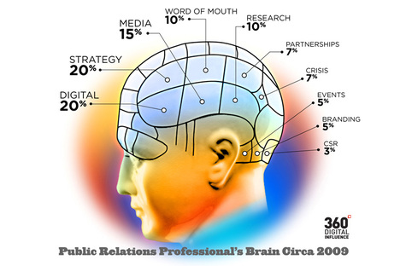
Georgia PR in Crisis
Case Study:
“Russian-Georgian War”, 2008

Slide 5
Georgia PR and Business
Public Opinion Research
Image Making of Organization
Communication with Media
Event Management
Working with Target Groups
Working on Communication Policy

Slide 6
Georgia PR and NGOs
Popularization of the Organization
Establishing and Developing Communication
Tools with Target Groups
Preserving the Image among Donors

Slide 7
Georgia …so called “Black” PR
Post-Soviet Tendency
Manipulation of the Society

Slide 8
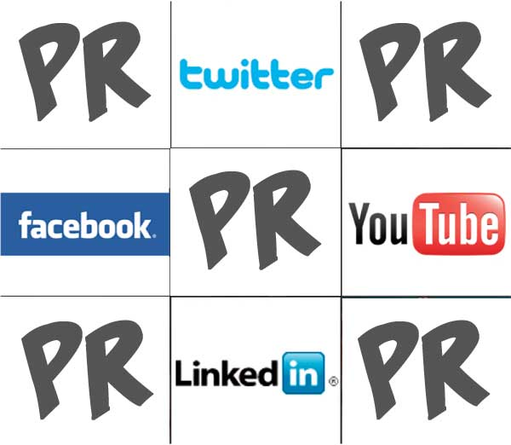
Georgia PR and New Media
Case-Study:
TBC Bank’s Smart Club on Facebook

